Slide 1
^{©2016 hermanamargarita.com}

Slide 2
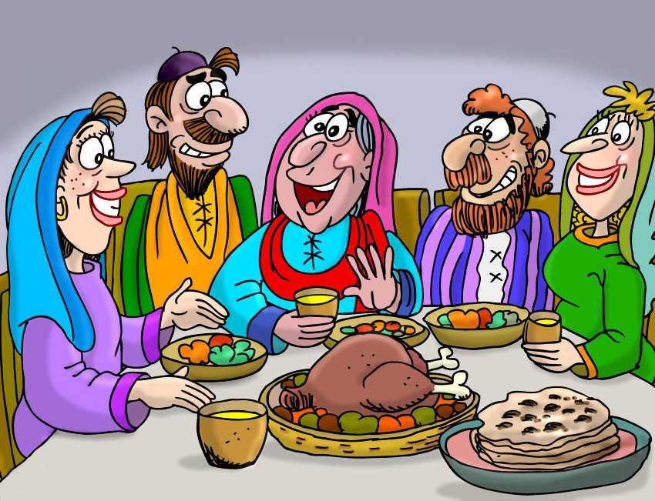

Slide 3
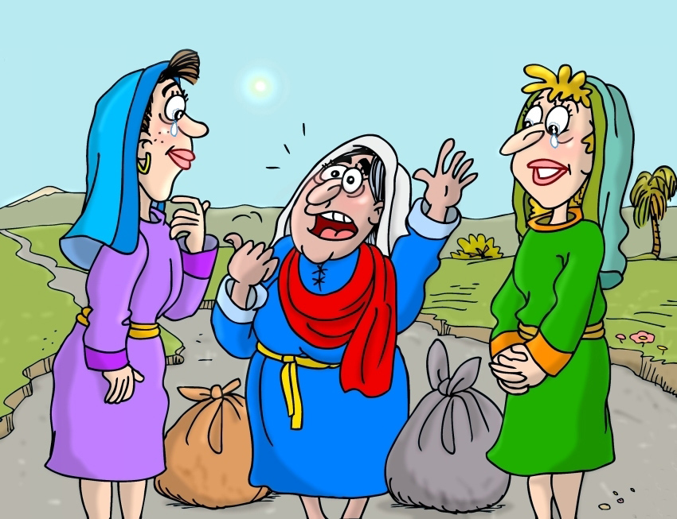

Slide 4
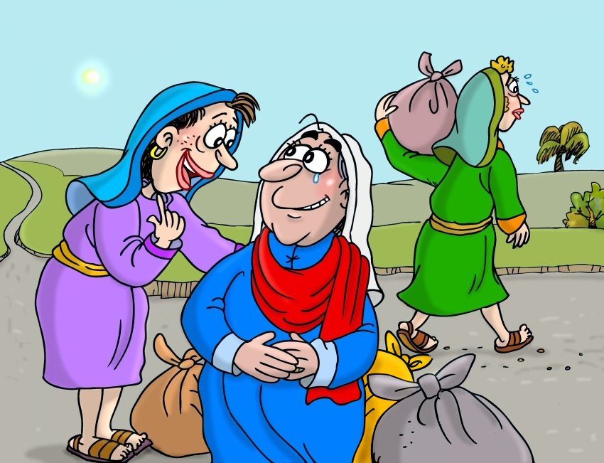

Slide 5
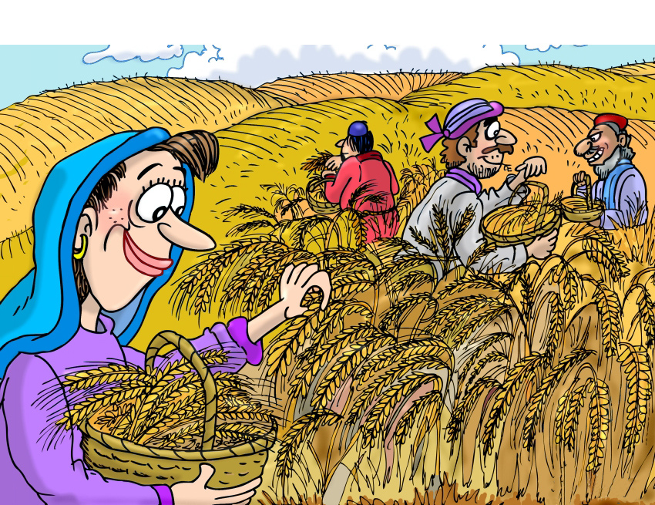

Slide 6
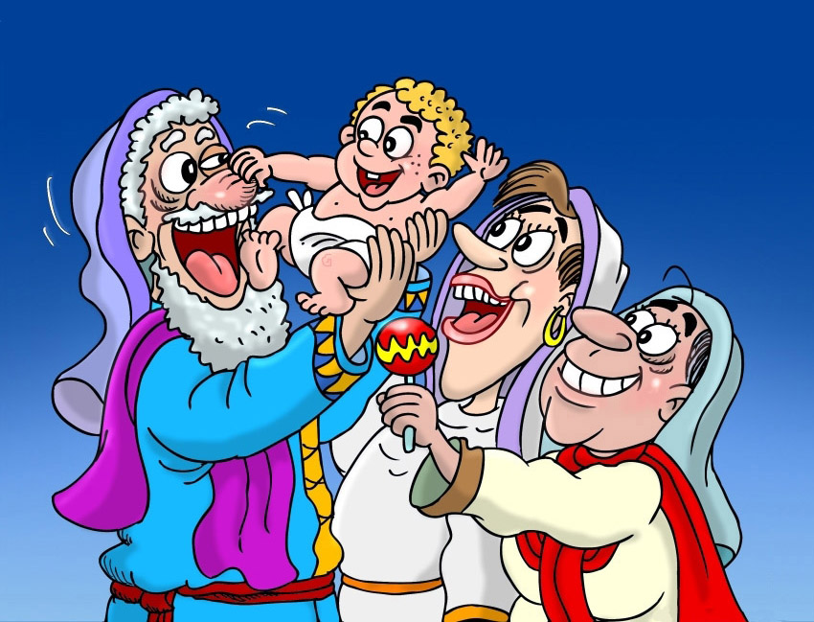

Slide 8
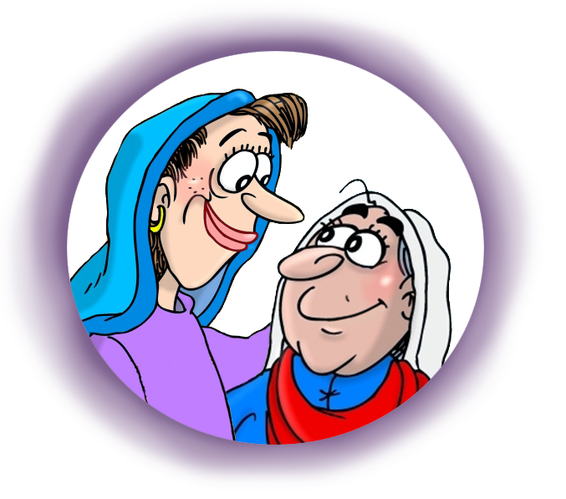
Arte: Absalóm-León Sixco
^{©2016 hermanamargarita.com}

